Slide 1
Operating System’s
System Security

Slide 2


PBR VISVODAYA INSTITUTE
OF TECHNOLOGY AND SCIENCE
System Security
through
Cryptography, User Authentication, and firewalling
Sit back relax & enjoy the show

Slide 3


WHAT WE ARE GOING TO DISCUSS
Cryptography
Trust through confidentiality
Encryption
Ensuring Data Security
FIREWALLING
What is firewall
Securing system and networks
1
System Security
USER AUTHENTICATION
Passwords
Vulnerabilities
Encrypting passwords
One-Time-Password
Biometrics
3
2

Slide 4

Cryptography

Slide 5
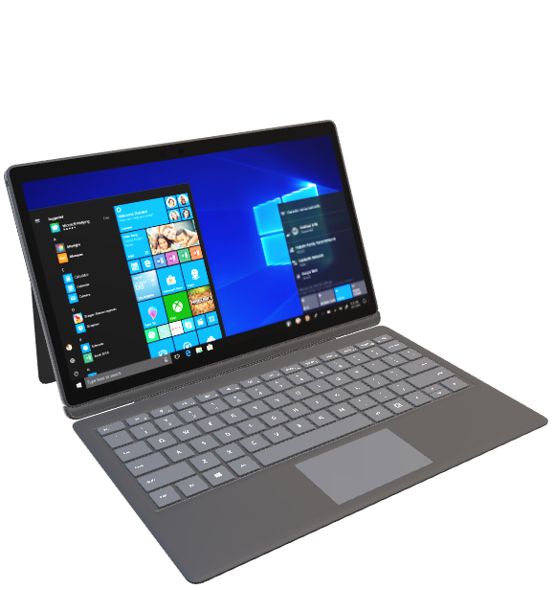

Trust & Confidentiality through
Cryptography
Trust and Security
Confidentiality
Cryptography provides the foundation for secure communication by ensuring the integrity and authenticity of data.
protects sensitive information from unauthorized access, creating a secure channel for data transmission.
Encryption

Slide 6

Encryption
: Balancing Security and Efficiency
1
Symmetric Encryption
The same key is used for both encryption and decryption. It is efficient but requires secure distribution of the key.
2
Asymmetric Encryption
Uses a pair of keys: public key for encryption and private key for decryption. Provides secure key exchange but is computationally expensive.

Slide 7
LIVE EXAMPLE
See how encryption & decryption happens here:
endecryplink

Slide 8
Ensuring Data Security
Threats
Prevention Measures
Data Breaches
Implement strong encryption and access controls
Malware Attacks
Use antivirus software and regularly update systems
Social Engineering
Train employees on security best practices

Slide 9

System Security
Through
User Authentication

Slide 10
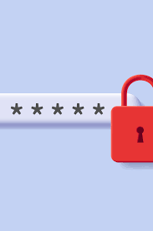
The Role of Passwords
1
Strong & Unique Passwords
2
Multi-Factor Authentication
Create passwords that are difficult to guess and use different passwords for each account.
Add an extra layer of security by combining passwords with additional authentication methods.
3
Password Managers
Simplify your life and enhance security by using password managers to securely store and generate complex passwords.

Slide 11
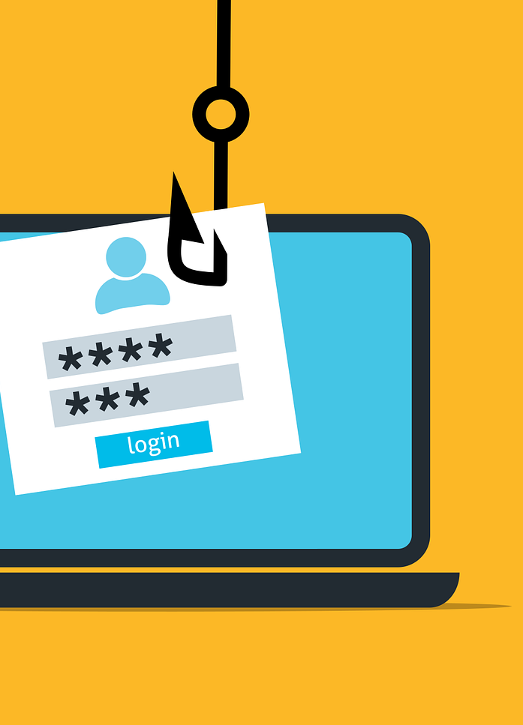
Addressing Password Vulnerabilities
1
Brute Force Attacks
2
Phishing Attacks
Educate users about identifying and avoiding phishing scams to protect their login credentials.
Implement account lockouts and rate limiting to prevent automated guessing of passwords.
3
Account Recovery
Strengthen account recovery processes to prevent unauthorized access to user accounts.

Slide 12
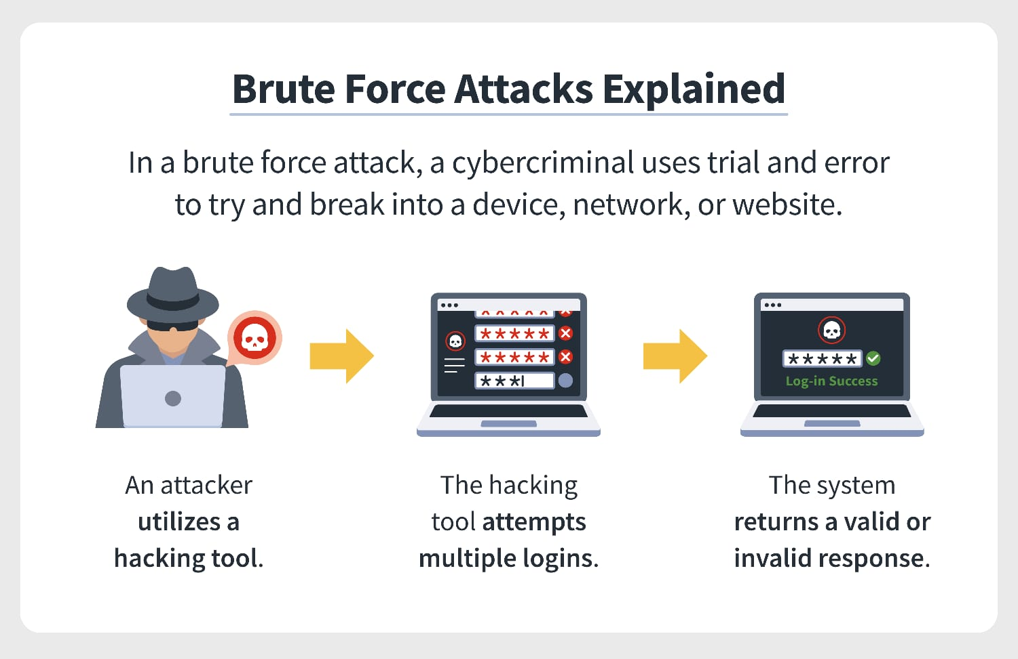
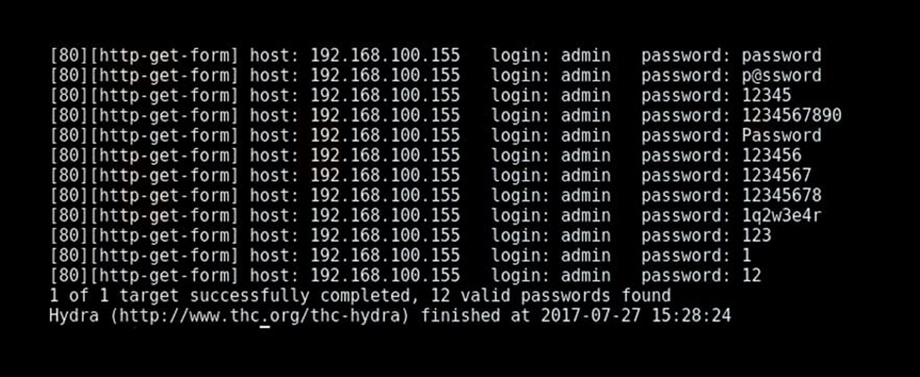

Slide 13
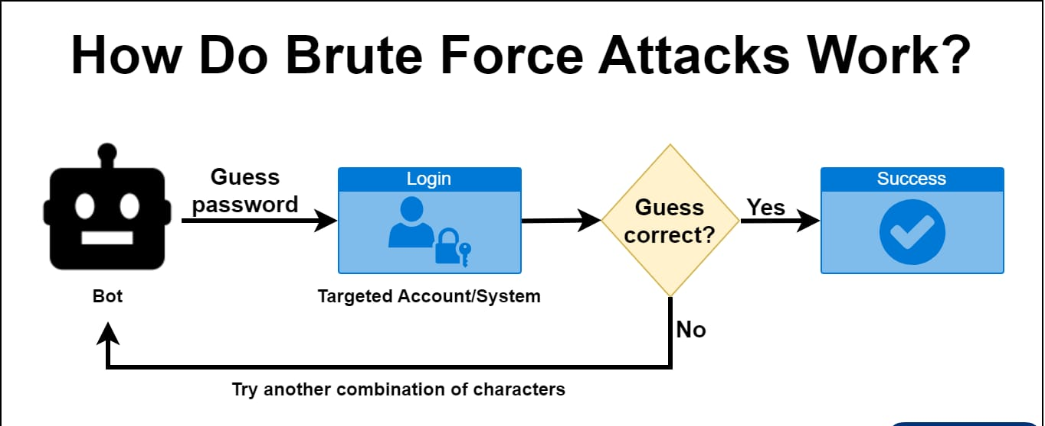

Slide 14
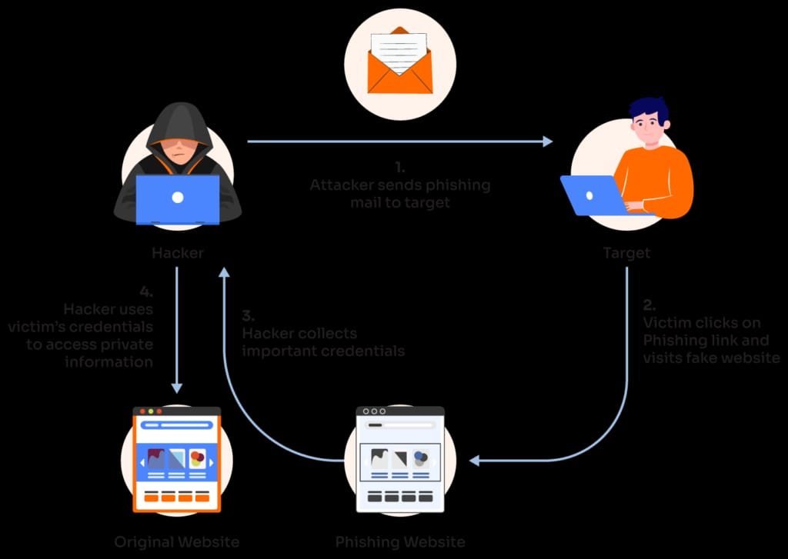
Phishing Attacks

Slide 15
LIVE EXAMPLES
1
Brute Force Attacks
https://loginpageforvits.netlify.com
2
Phishing Attacks
https://codepen.io/mraryanjain/pen/MWzvbeN

Slide 16
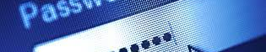
Enhancing Security with Encrypted Passwords
1
Salt and Hash
2
Key Management
3
Password Policies
Protect passwords by salting and hashing them using strong cryptographic algorithms.
Securely manage encryption keys to prevent unauthorized access to sensitive data.
Enforce strict password policies, including minimum length, complexity requirements, and regular password updates.

Slide 17
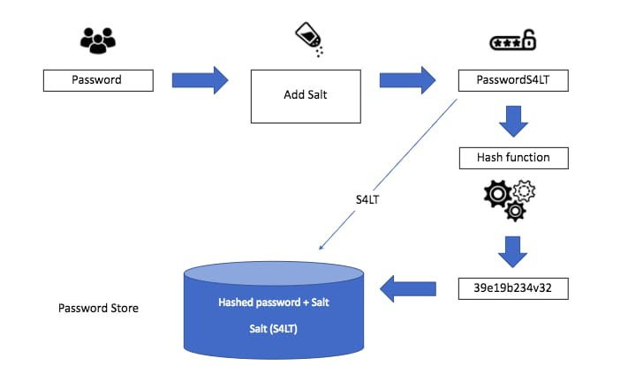
Salt and Hash

Slide 18
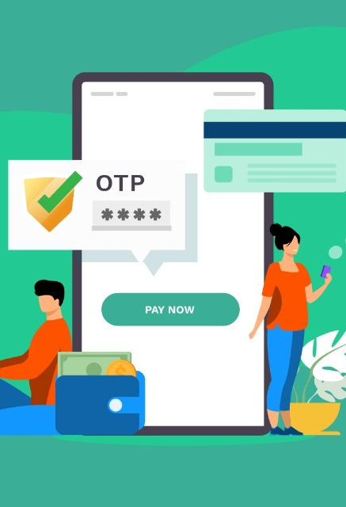
The Power of One-Time Passwords
1
Time-Based OTP (TOTP)
2
Hardware Tokens
Use physical devices that generate one-time passwords for enhanced security and convenience.
Generate unique authentication codes that expire after a short period of time, adding an extra layer of security.
3
SMS-Based OTP
Receive one-time passwords via SMS messages for quick and easy authentication.

Slide 19

Securing Systems with Biometrics
1
Fingerprint Scanners
2
Facial Recognition
Enhance security by analyzing unique facial features and matching them against stored data.
Utilize fingerprint recognition to allow access only to authorized individuals.
3
Iris Scanning
Use advanced iris scanning technology for accurate and reliable user authentication.

Slide 20

Firewalling

Slide 21
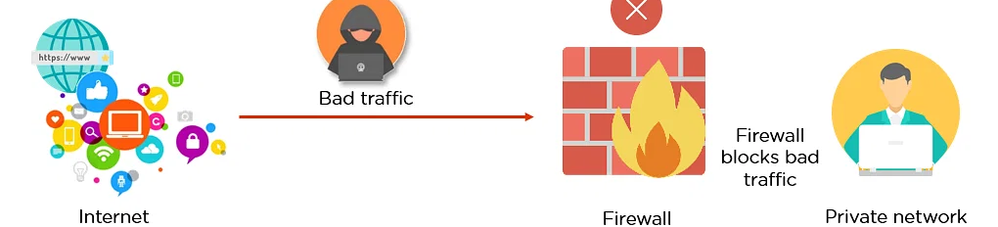
Firewall
What is a
A firewall is a network security device or software that monitors and controls incoming and outgoing network traffic based on predefined security rules, helping protect a computer or network from unauthorized access and threats.

Slide 22
LIVE EXAMPLES
Firewall
http://myphoneoffer.com

Slide 23
Firewall
Different Types of
Personal Firewall
Application Proxy Firewall
A personal firewall provides individual users with control over inbound and outbound network traffic, protecting their devices from unauthorized access.
Application proxy firewalls operate at the application layer of the network stack, acting as intermediaries between client devices and external systems.
XML Firewall
System Call Firewalls
XML firewalls specialize in securing XML-based communication systems by preventing XML-specific attacks and enforcing XML parsing rules.
System call firewalls monitor and control system calls made to the operating system, ensuring that only authorized actions are executed.

Slide 24
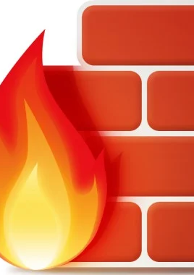
Choosing the Right Firewall Configuration
Consider the specific requirements of your systems and networks to determine the optimal combination of firewall types, rules, and configurations. Protect your assets effectively.

Slide 25
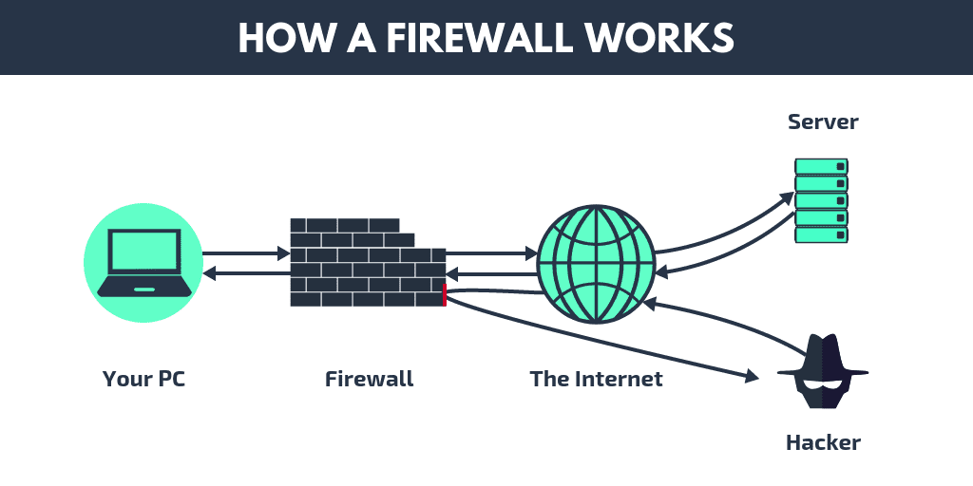
Effective Firewall Management and Administration
Learn best practices for firewall management, including regular updates, rule reviews, and monitoring for potential threats. Strengthen your defense against evolving security risks.

Slide 26
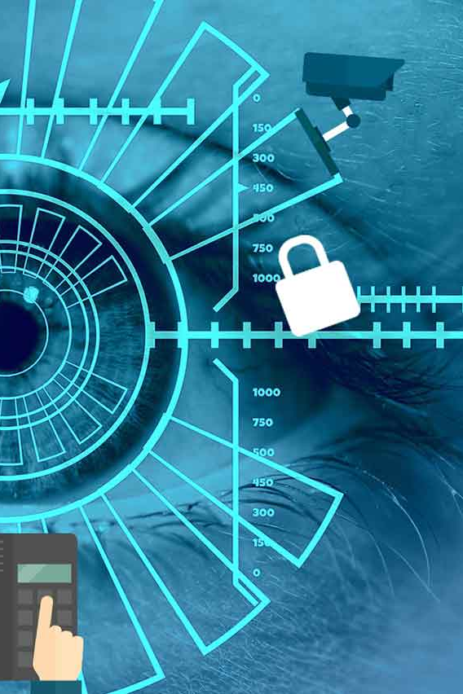
Conclusion
Effective user authentication plays a crucial role in safeguarding sensitive information. By combining multiple methods and staying up to date with emerging technologies, we can build robust and secure systems. Remember, protecting your data starts with a strong line of defense.

Slide 27

Any Queries Guys!?

Slide 28

Conclusion
Effective user authentication plays a crucial role in safeguarding sensitive information. By combining multiple methods and staying up to date with emerging technologies, we can build robust and secure systems. Remember, protecting your data starts with a strong line of defense.

